Slide 1


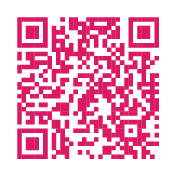
Enhance Your POLST Knowledge and Skills With
Free On-Demand CE!
Now available from Pennsylvania POLST!
10 self-paced online continuing education modules
Gain the skills you need to have quality end-of-life conversations
Module Topics
Fundamentals of POLST
Advance directives
Tools and strategies for
having POLST conversations
POLST implementation
Medicare reimbursement
Cultural humility
Pediatrics
EMS and POLST
Earn 11 Free CME/CNE Credits!
Get started today!
www.papolst.org/learning-center/polst-self-study
Developed with support from the Jewish Healthcare Foundation and the McElhattan Foundation

